Slide 1

Massachusetts institute of Technology
Physics
Notes:
What to talk about

Slide 2
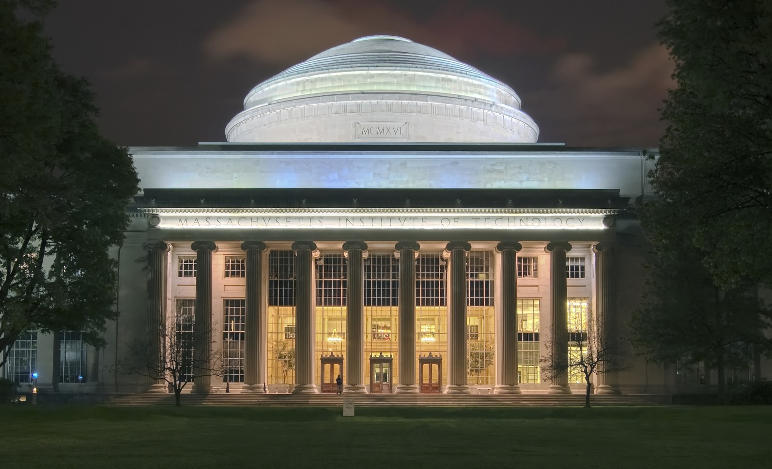

The School
Campus
Community
Study options
Accomadation
Cambridge
Notes:
Campus
4000*168 = 672km^2
Dividet into two
First years on campus
Community
Freshmen have to stay on campus
Clubs and groups
Study options
Architecture and planning
Engineering
Humanities, Art and Social Sience
Science
Accomadation
70% live on campus
Lots of activities
Cambridge
Old town
Devided into squares
Brickhouses
About the same temperatures as in Norway

Slide 3

Department of Physics
Course VIII
Focused Option
Flexible Option
Notes:
The undergraduate degree in physics is devided
Focused option
Preparing for graduate studies
Lots of different paths
Some requirements, mostly experimental requirements
Flexible option
Focus on giving a basic understanding and researchabillity in physics
Example - Astronomy
12.400 (3-0-9) The Solar System
8.284 (3-0-9) Modern Astrophysics
8.286 (3-0-9) The Early Universe
to satisfy the experimental requirement: 12.410J (2-4-6) Observational Techniques of Optical Astronomy

Slide 4
Sources
http://web.mit.edu/facts/community.html
http://web.mit.edu/facts/housing.html
http://web.mit.edu/facts/campus.html
http://web.mit.edu/facts/academic.html
http://en.wikipedia.org/wiki/Cambridge,_Massachusetts
http://en.wikipedia.org/wiki/Massachusetts_Institute_of_Technology#Campus
http://web.mit.edu/physics/current/undergrad/major.html
http://housing.mit.edu/undergraduate/undergraduate_housing

